Slide 1
AWS SageMaker
Kevin Kho

Slide 2
Housekeeping
Introduction
Github repo: https://github.com/orlmlds/aws-sagemaker-intro
Discord: https://discord.gg/wUvqmZ
Google Form: https://docs.google.com/forms/d/e/1FAIpQLSf9sWdqnYcTCe4CPL0dnXafNquFiQR5ZE0jFtwA6v7R2xkExQ/viewform?usp=sf_link
Source: https://aws.amazon.com/machine-learning/ai-services/

Slide 3
Outline
Introduction
AWS Managed Services
AWS SageMaker AutoPilot
AWS SageMaker Notebooks
Fully Managed
Source: https://aws.amazon.com/machine-learning/ai-services/

Slide 4
AWS SageMaker (Re:Invent 2018)
SageMaker Features
Build
Development environment
Train
Elastic compute
Performance
Deploy
Real-time endpoints
Batch jobs
Frameworks
Model Tuning
Source: https://www.youtube.com/watch?v=jWWyKE5ApqI

Slide 5
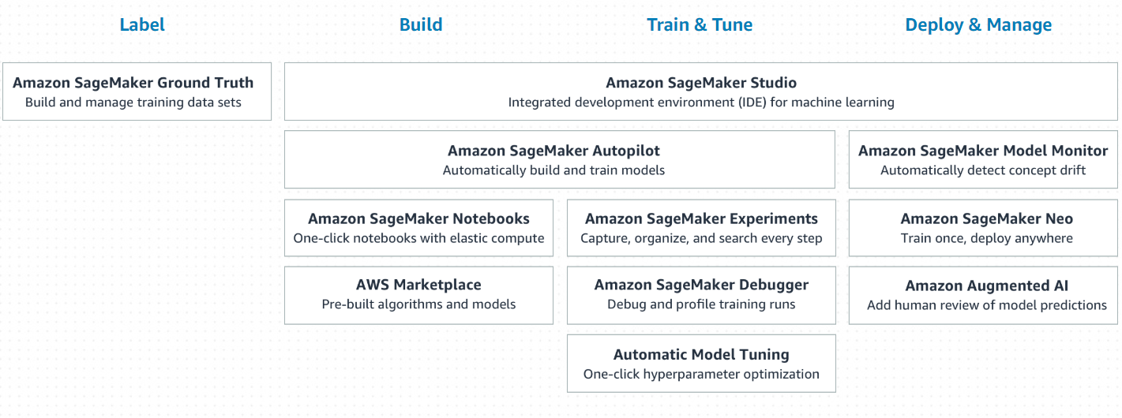
AWS SageMaker (Re:Invent 2019)
SageMaker Features
Source: https://aws.amazon.com/sagemaker/

Slide 6
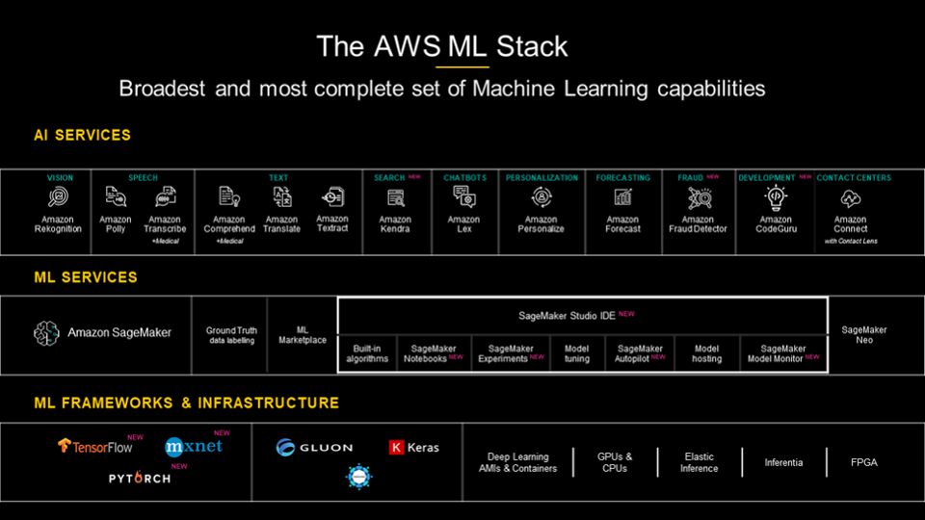
AWS SageMaker versus AWS AI Services
AI Services
Source: https://www.forbes.com/sites/moorinsights/2020/03/04/surprise-aws-leads-in-cloud-ai-services-ranking/#7948223a5ff7

Slide 7
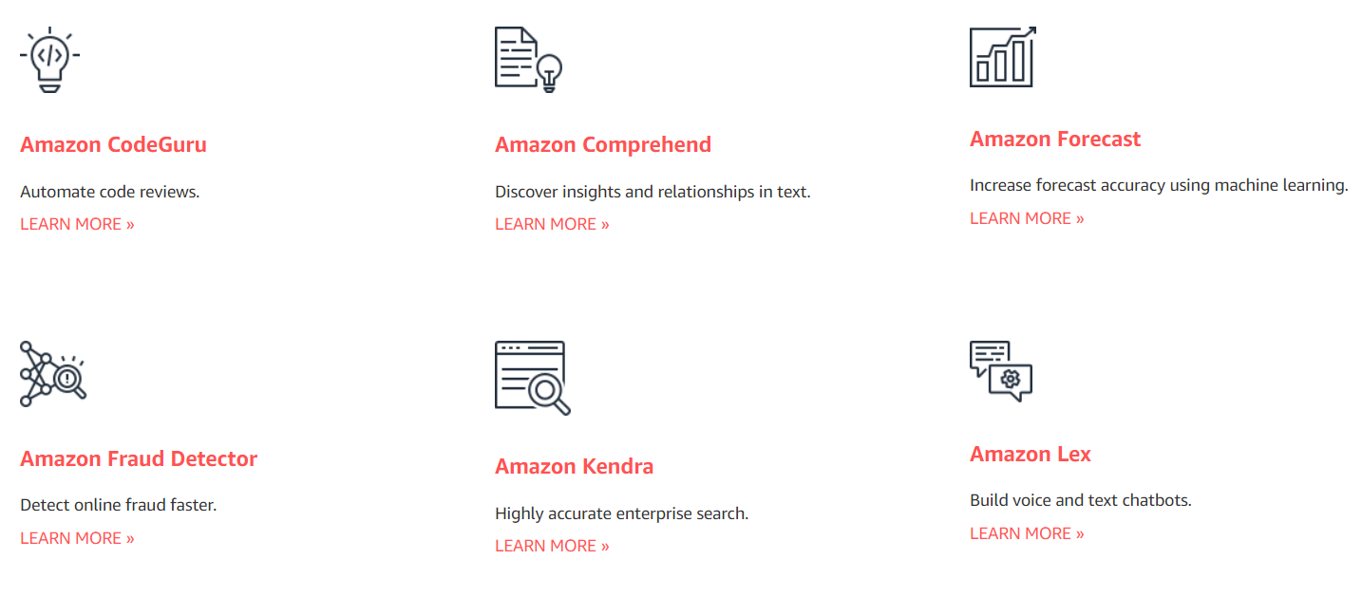
AWS AI Services
AI Services
Source: https://aws.amazon.com/machine-learning/ai-services/

Slide 8
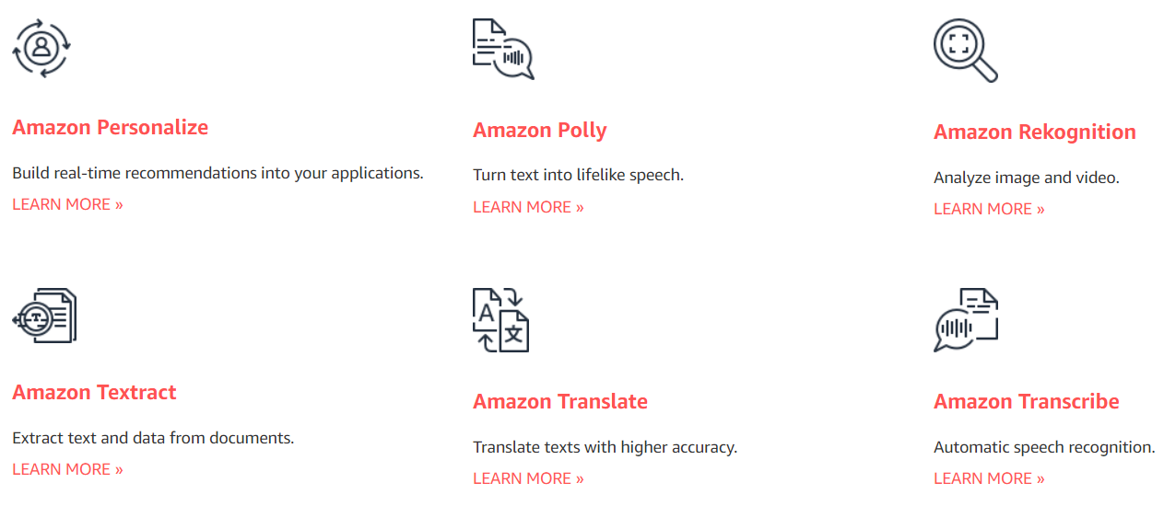
AWS AI Services
AI Services
Source: https://aws.amazon.com/machine-learning/ai-services/

Slide 9
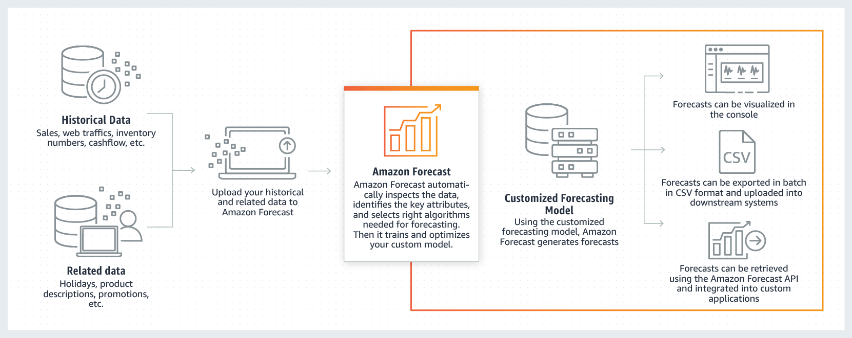
AWS Forecast
AI Services
Source: https://aws.amazon.com/forecast/

Slide 10

AWS Rekognition
AI Services
Source: https://aws.amazon.com/rekognition/

Slide 11

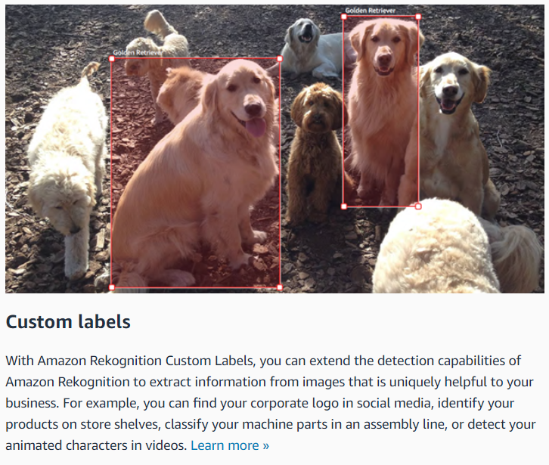
AWS Rekognition
AI Services
Source: https://aws.amazon.com/rekognition/

Slide 12
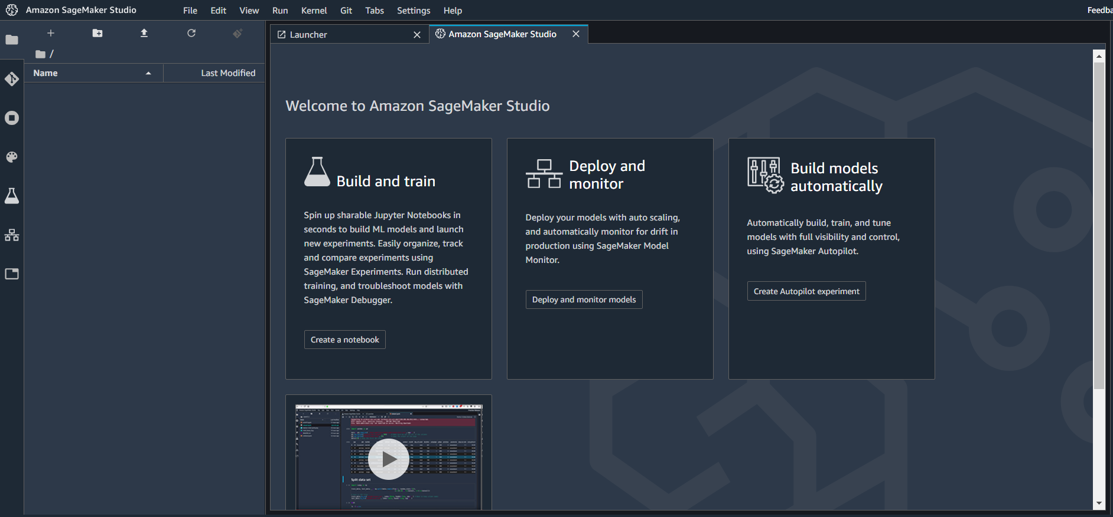
AWS SageMaker Studio
Autopilot

Slide 13
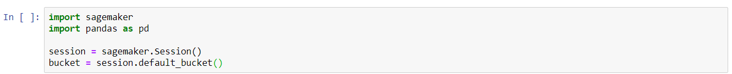
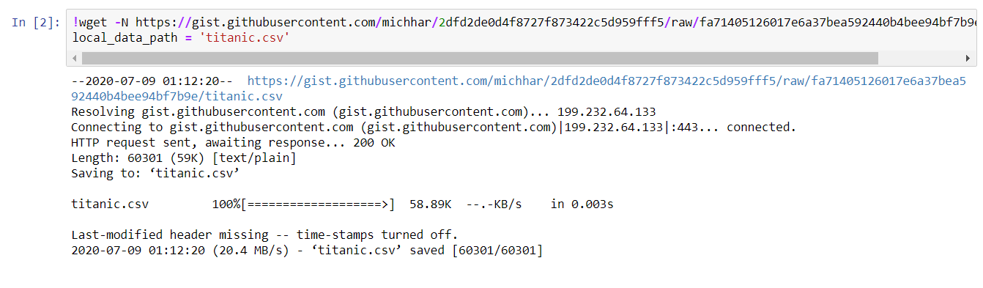
AWS SageMaker AutoPilot
AutoPilot

Slide 14
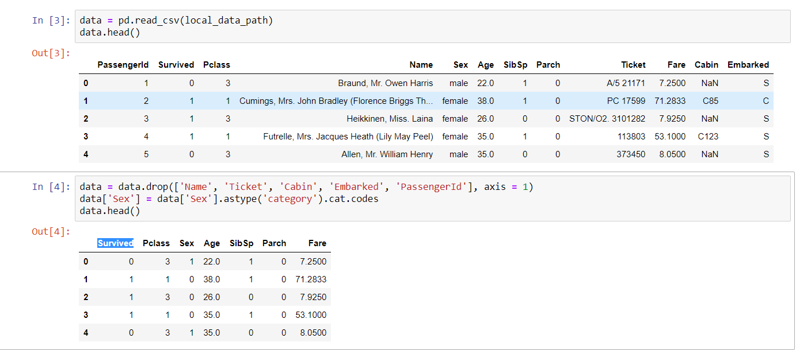
AWS SageMaker AutoPilot
AutoPilot

Slide 15
AWS SageMaker AutoPilot
AutoPilot

Slide 16
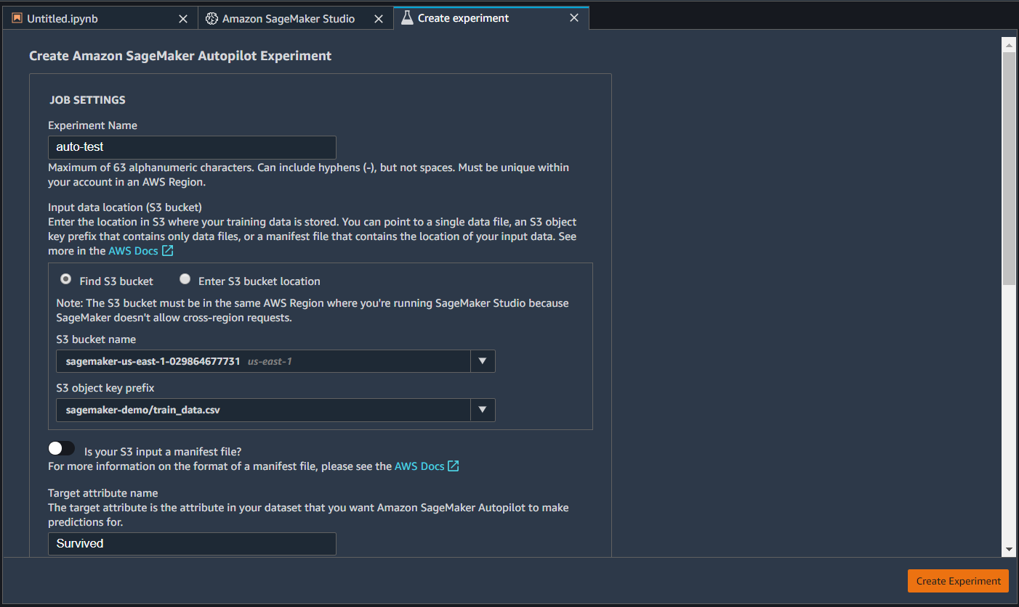
AWS SageMaker AutoPilot
AutoPilot

Slide 17
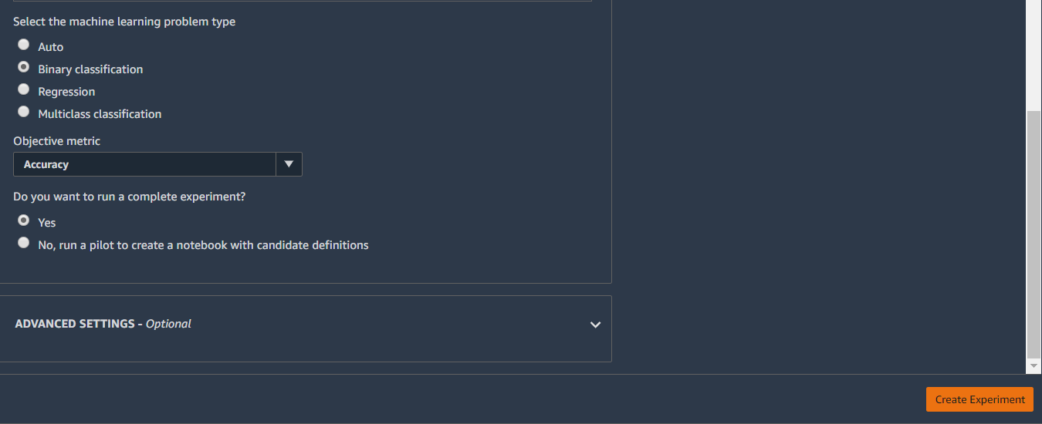
AWS SageMaker AutoPilot
AutoPilot

Slide 18
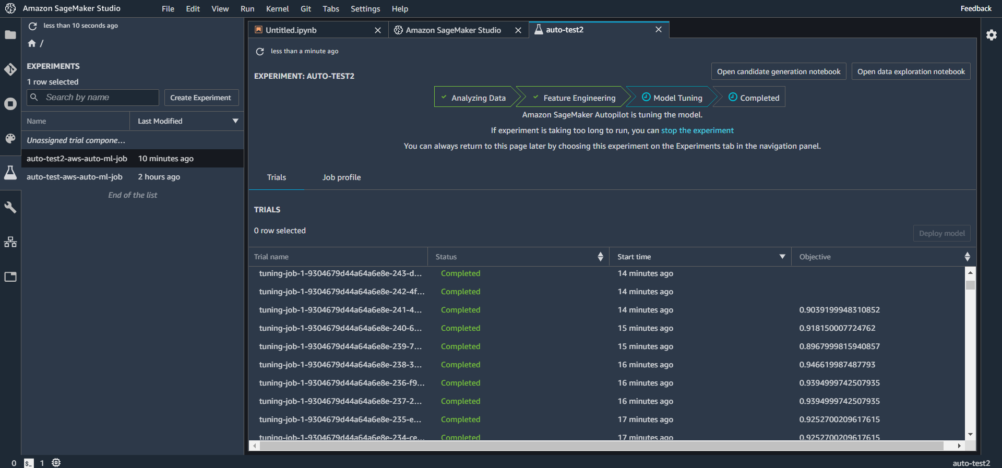
AWS SageMaker AutoPilot
AutoPilot

Slide 19
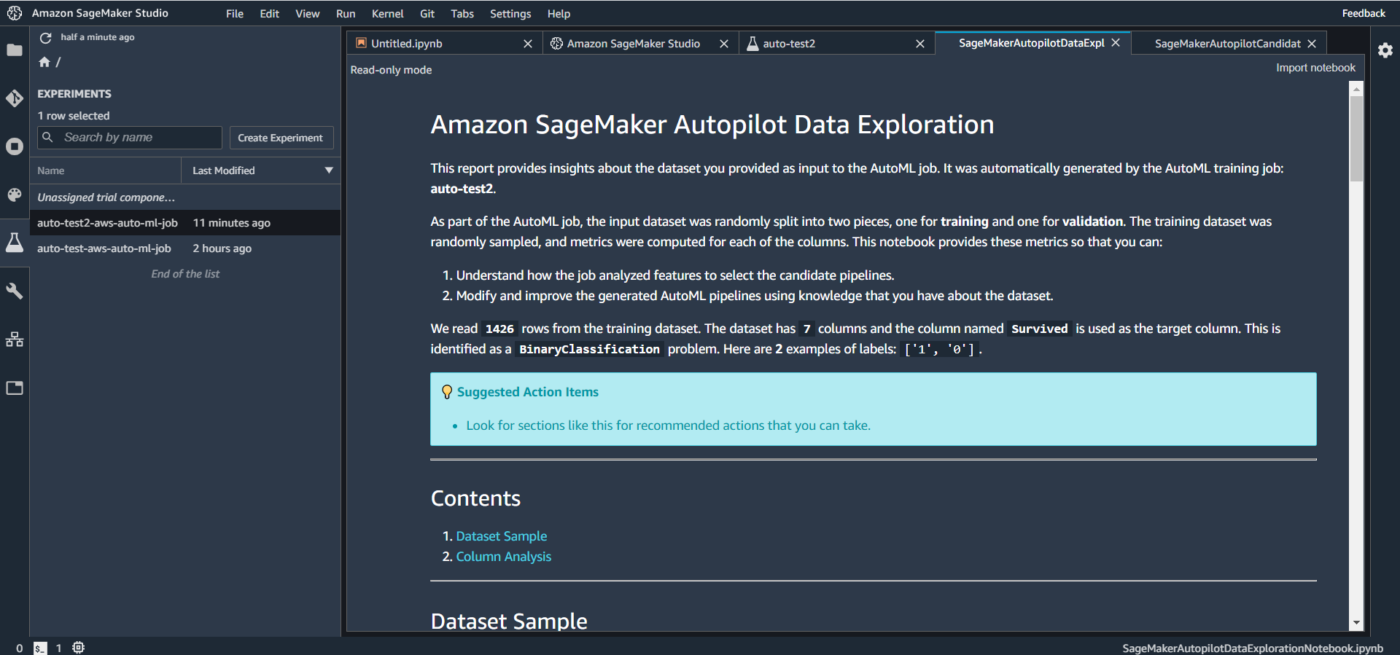
AWS SageMaker AutoPilot
AutoPilot

Slide 20
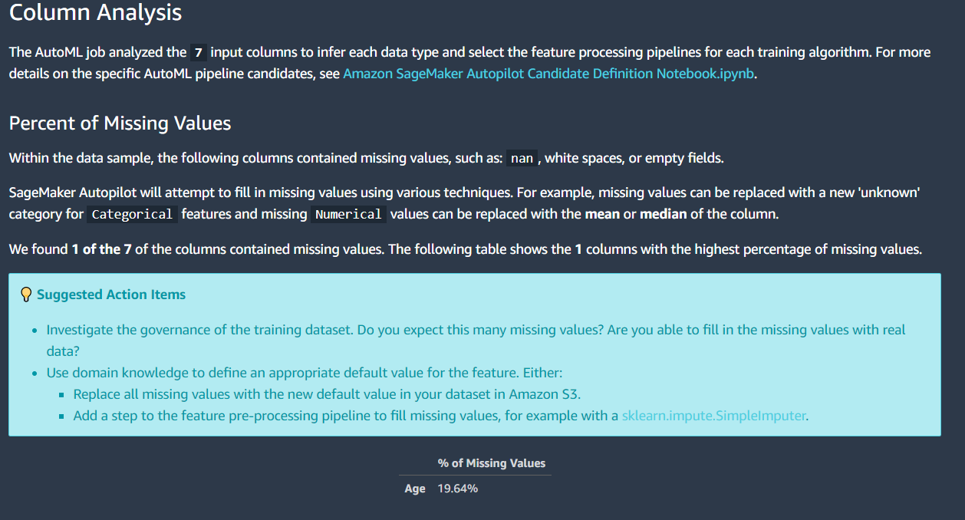
AWS SageMaker AutoPilot
AutoPilot

Slide 21
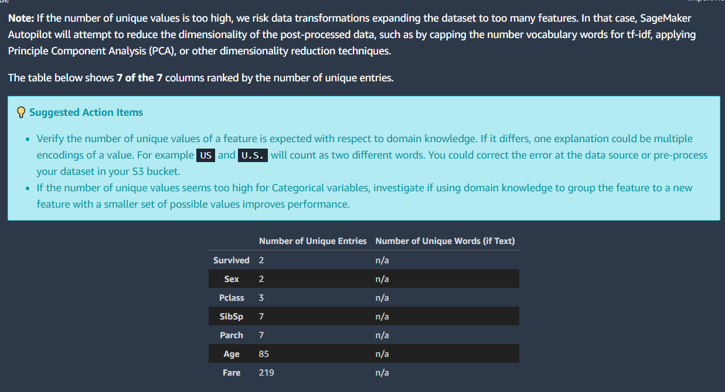
AWS SageMaker AutoPilot
AutoPilot

Slide 22
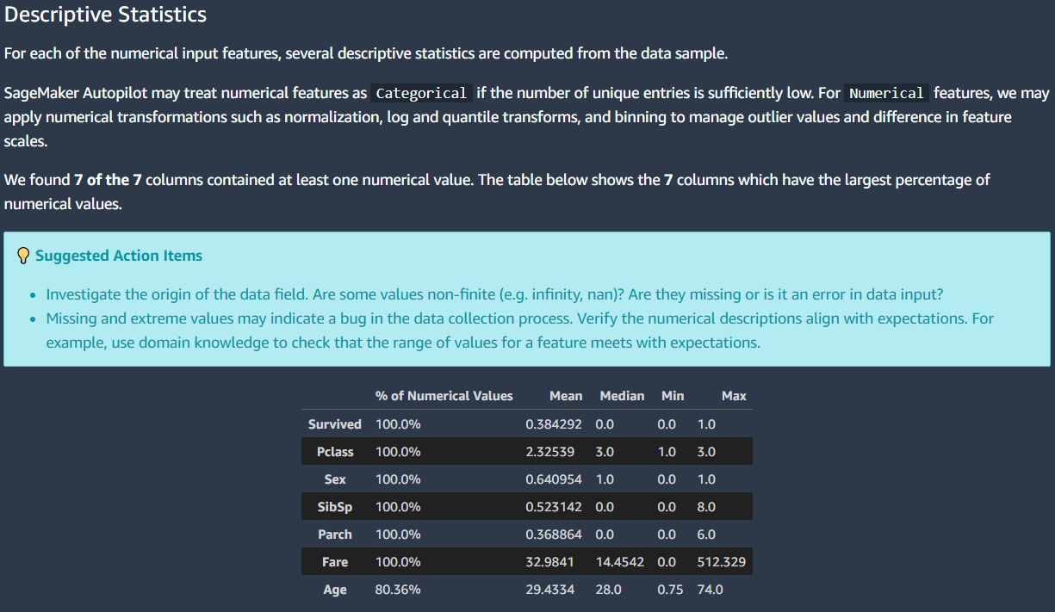
AWS SageMaker AutoPilot
AutoPilot

Slide 23
AWS SageMaker AutoPilot
AutoPilot

Slide 24
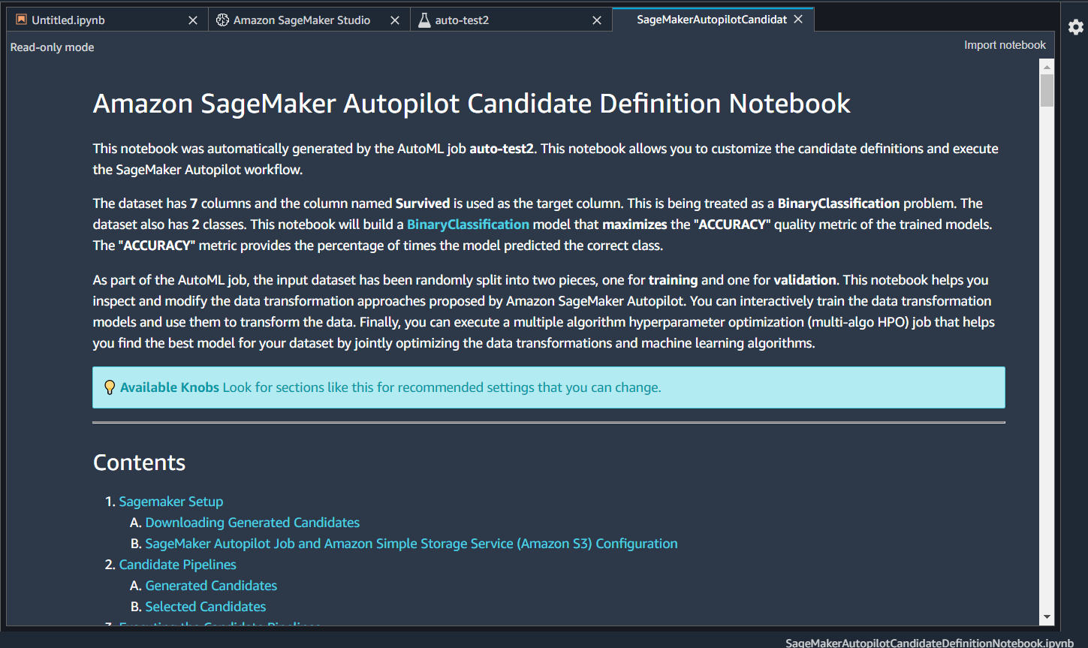
AWS SageMaker AutoPilot
AutoPilot

Slide 25
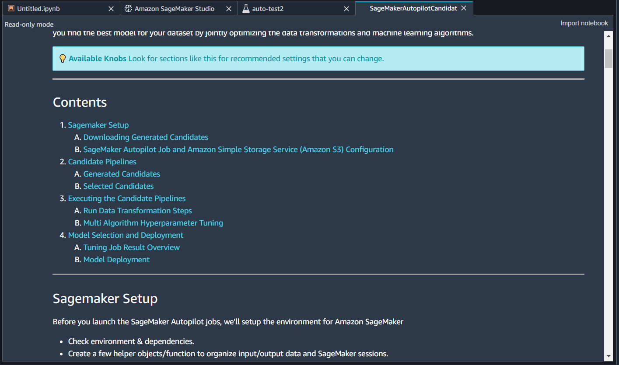
AWS SageMaker AutoPilot
AutoPilot

Slide 26
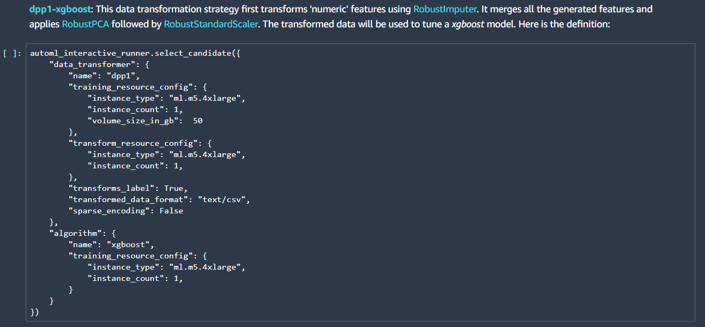
AWS SageMaker AutoPilot
AutoPilot

Slide 27
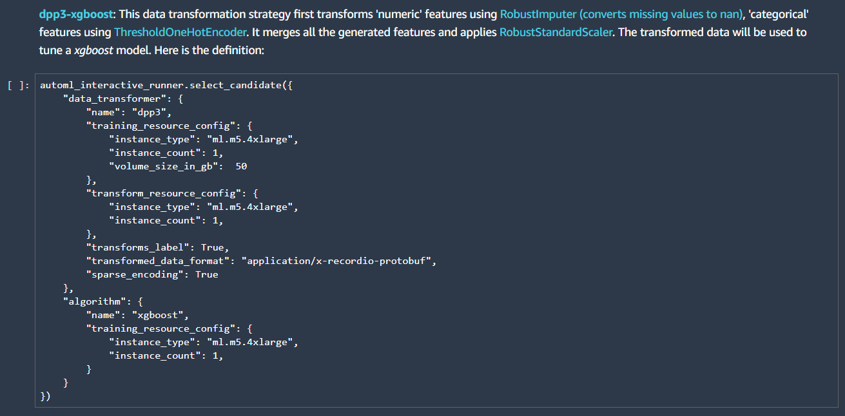
AWS SageMaker AutoPilot
AutoPilot

Slide 28
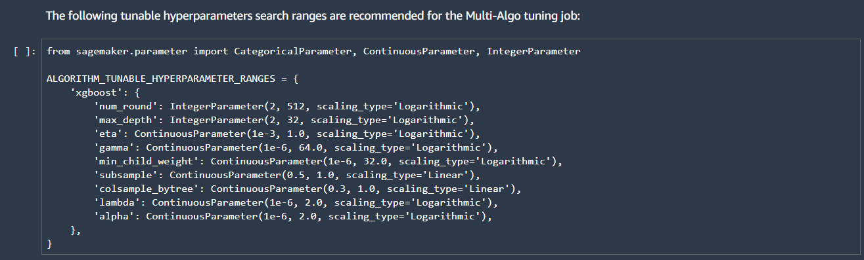
AWS SageMaker AutoPilot
AutoPilot

Slide 29
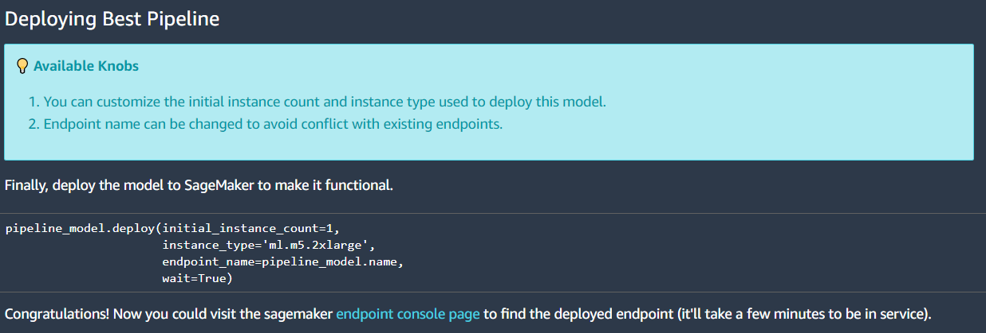
AWS SageMaker AutoPilot
AutoPilot

Slide 30
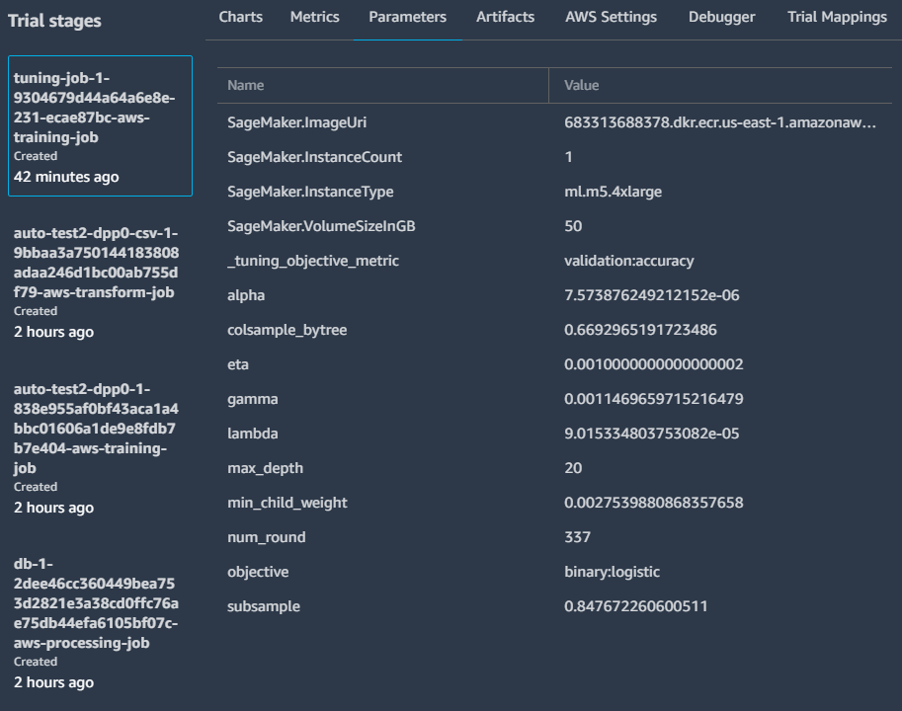
AWS SageMaker AutoPilot
AutoPilot

Slide 31
AWS SageMaker AutoPilot
AutoPilot
Pros
Actual deployable model

Slide 32
AWS SageMaker AutoPilot
AutoPilot
Cons
Expensive
Hard to trace what happened
Needs clean data
5 GB limit

Slide 33
AWS SageMaker (Re:Invent 2019)
SageMaker Features
Source: https://aws.amazon.com/sagemaker/

Slide 34
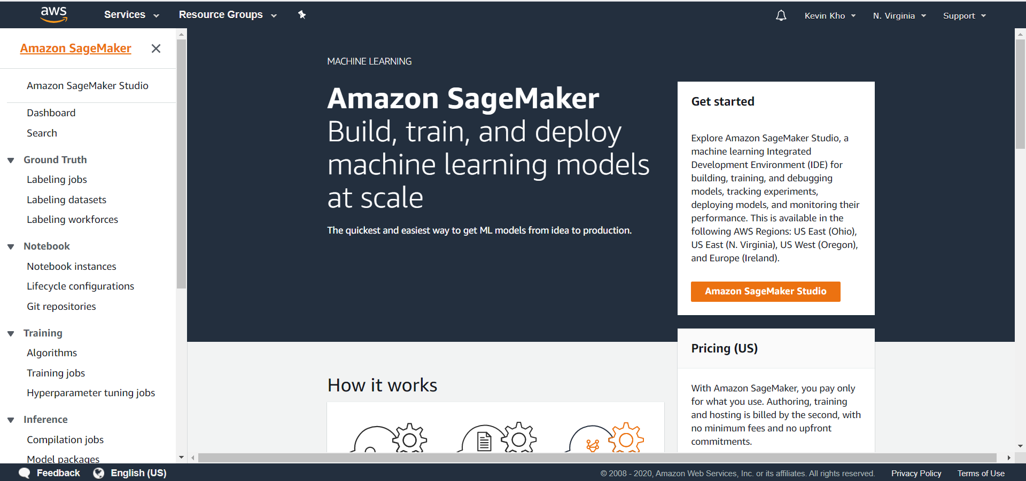
AWS SageMaker Ground Truth

Slide 35
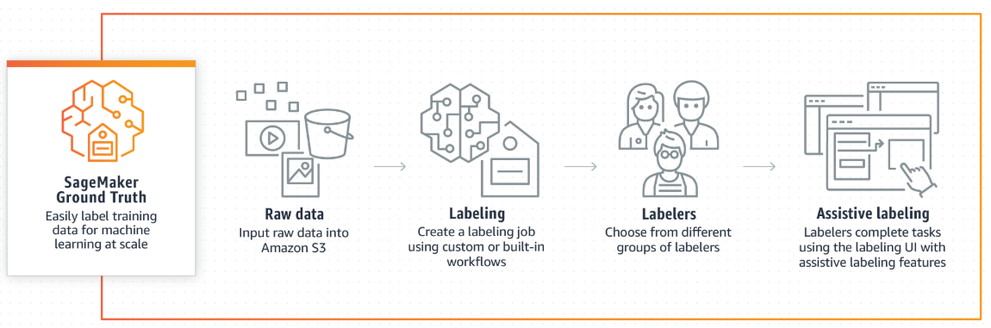
AWS SageMaker Ground Truth
Source: https://aws.amazon.com/sagemaker/groundtruth/
Notes:
This is really meant for NLP tasks and Computer Vision

Slide 36
Build

Slide 37
AWS SageMaker Notebooks
Build

Slide 38
General Notes
Build
S3 for storage
Containers – AWS ECR
Python, R seems newly supported

Slide 39
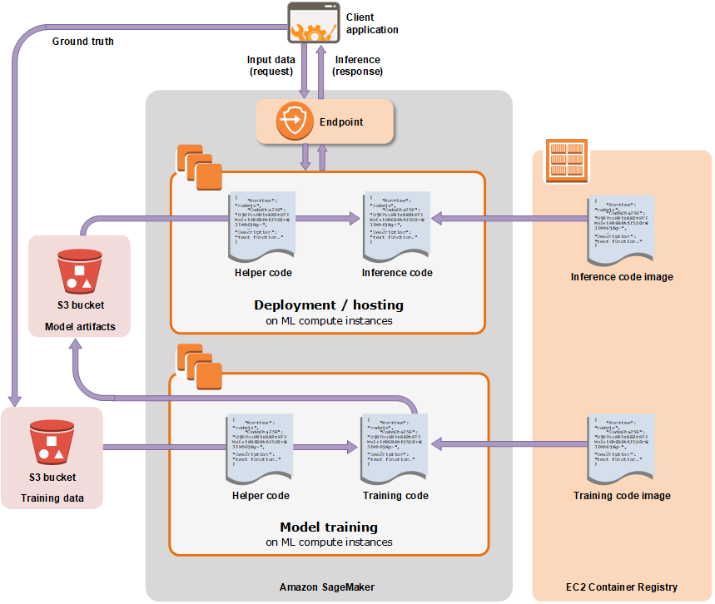
General Notes
Build
Source: https://docs.aws.amazon.com/sagemaker/latest/dg/how-it-works-training.html

Slide 40
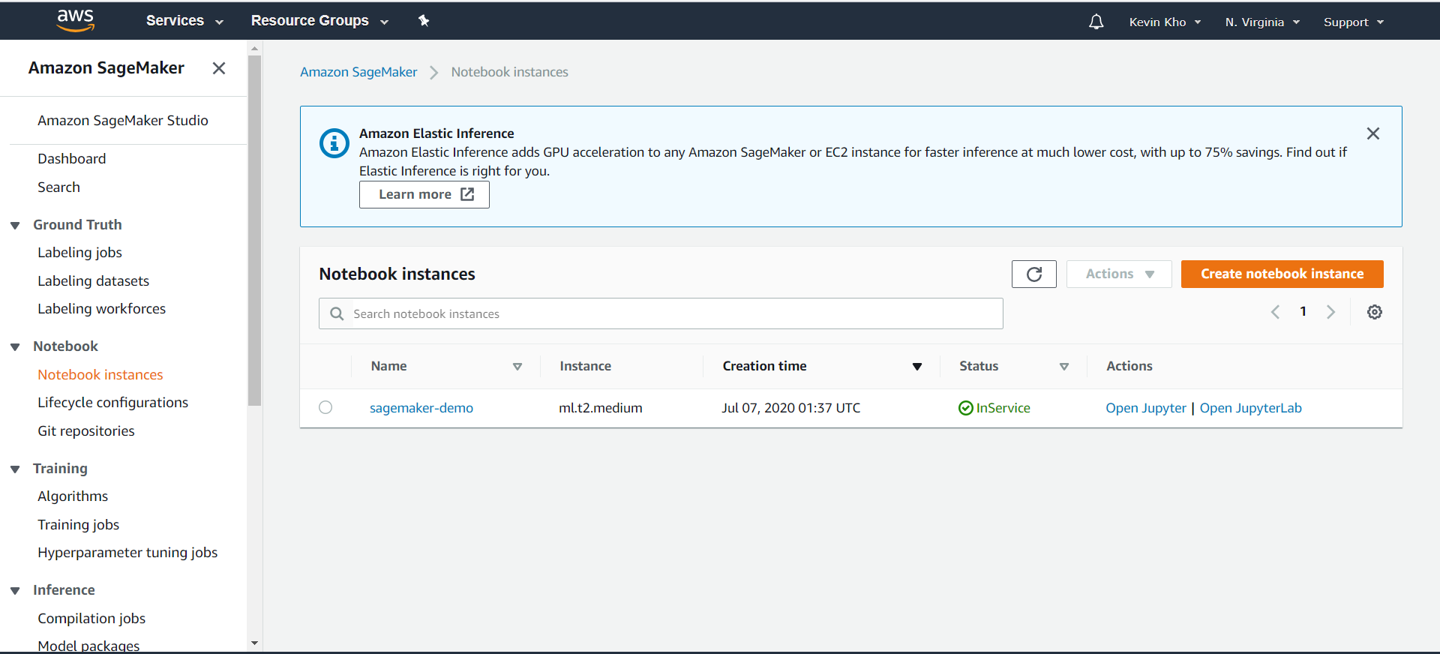
AWS SageMaker Notebooks
Build

Slide 41
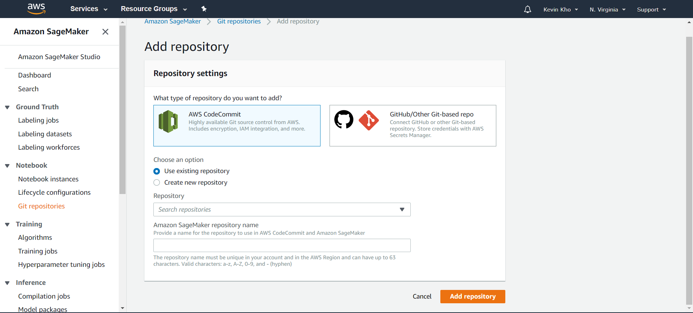
AWS SageMaker and Git
Build

Slide 42
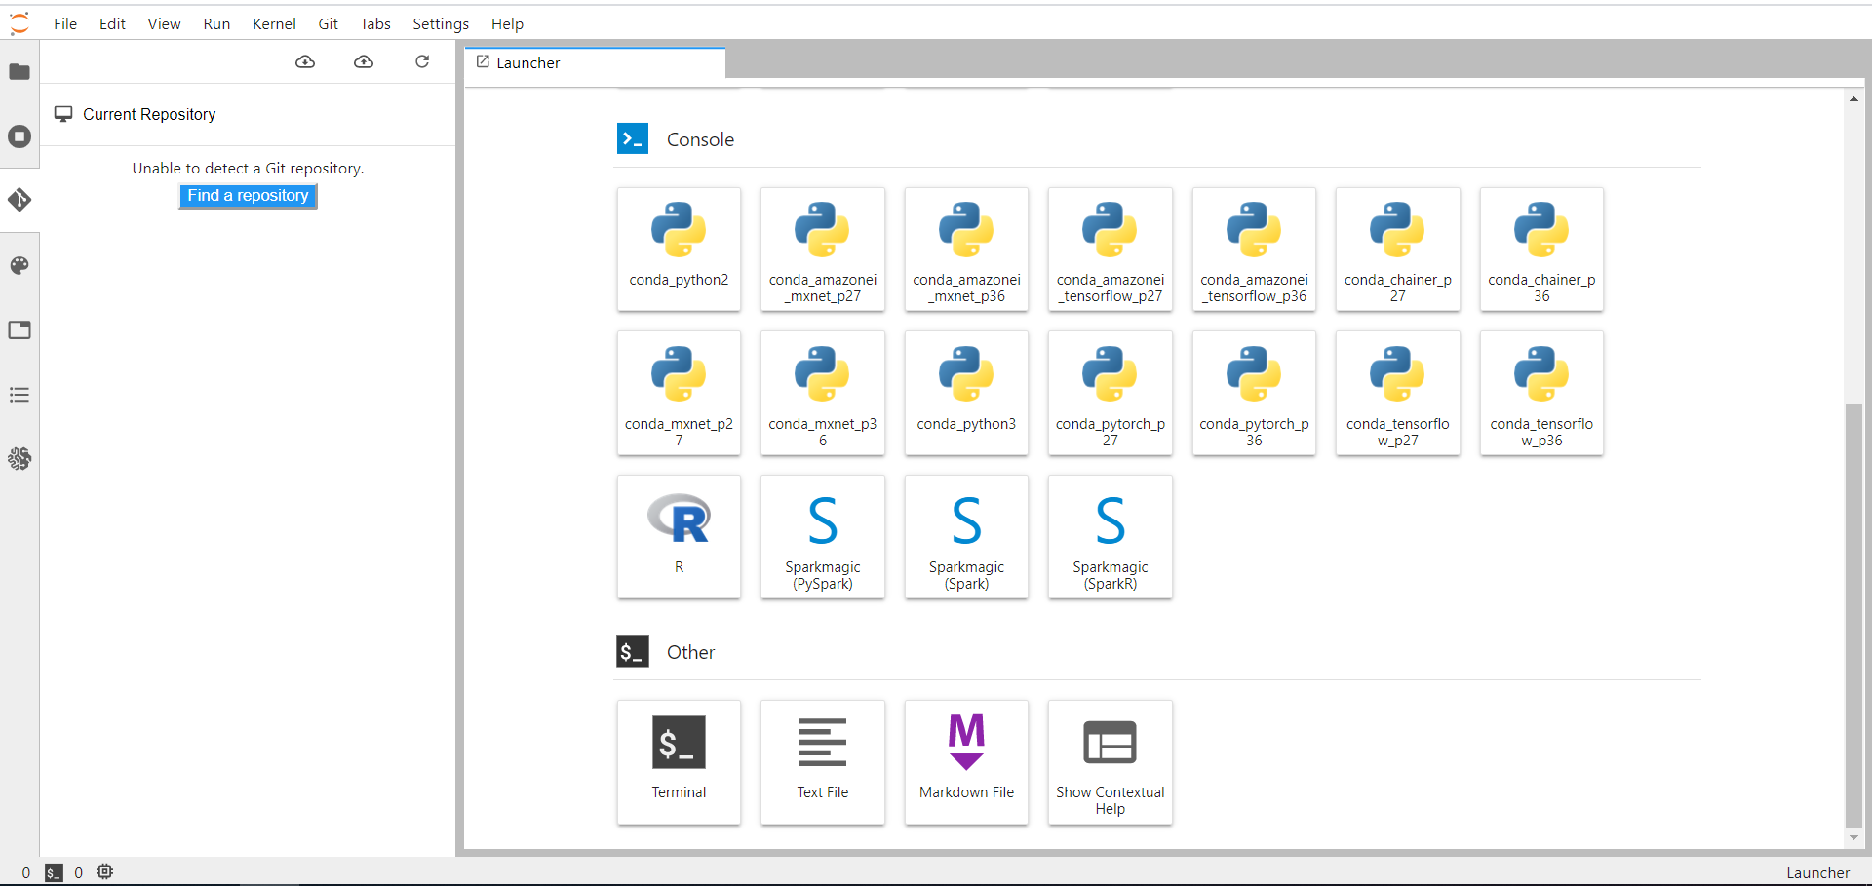
AWS SageMaker and Git
Build
Git through JupyterLab

Slide 43
Build Example

Slide 44
Training

Slide 45
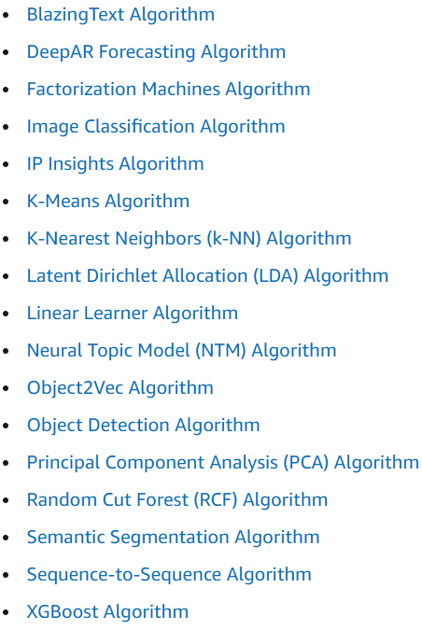
AWS Built-In Algorithms
Training
Source: https://docs.aws.amazon.com/sagemaker/latest/dg/algos.html

Slide 46
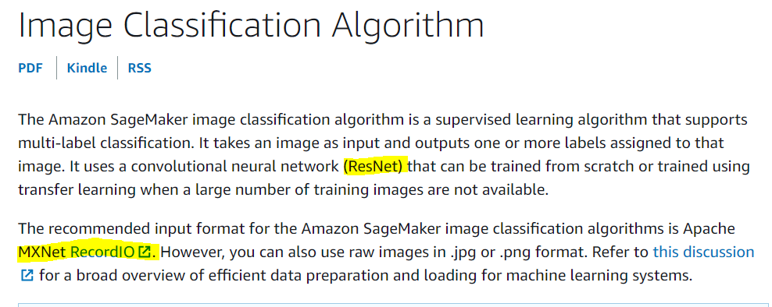
Built-in Algorithm Limitations
Training
AWS Documentation
Source: https://docs.aws.amazon.com/sagemaker/latest/dg/image-classification.html

Slide 47
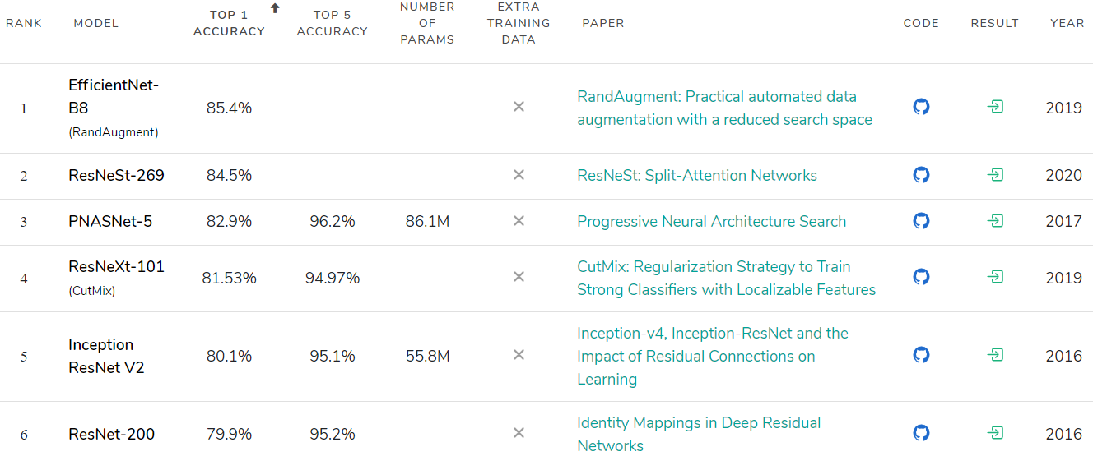
ImageNet Benchmark
Training
Source: https://paperswithcode.com/sota/image-classification-on-imagenet

Slide 48
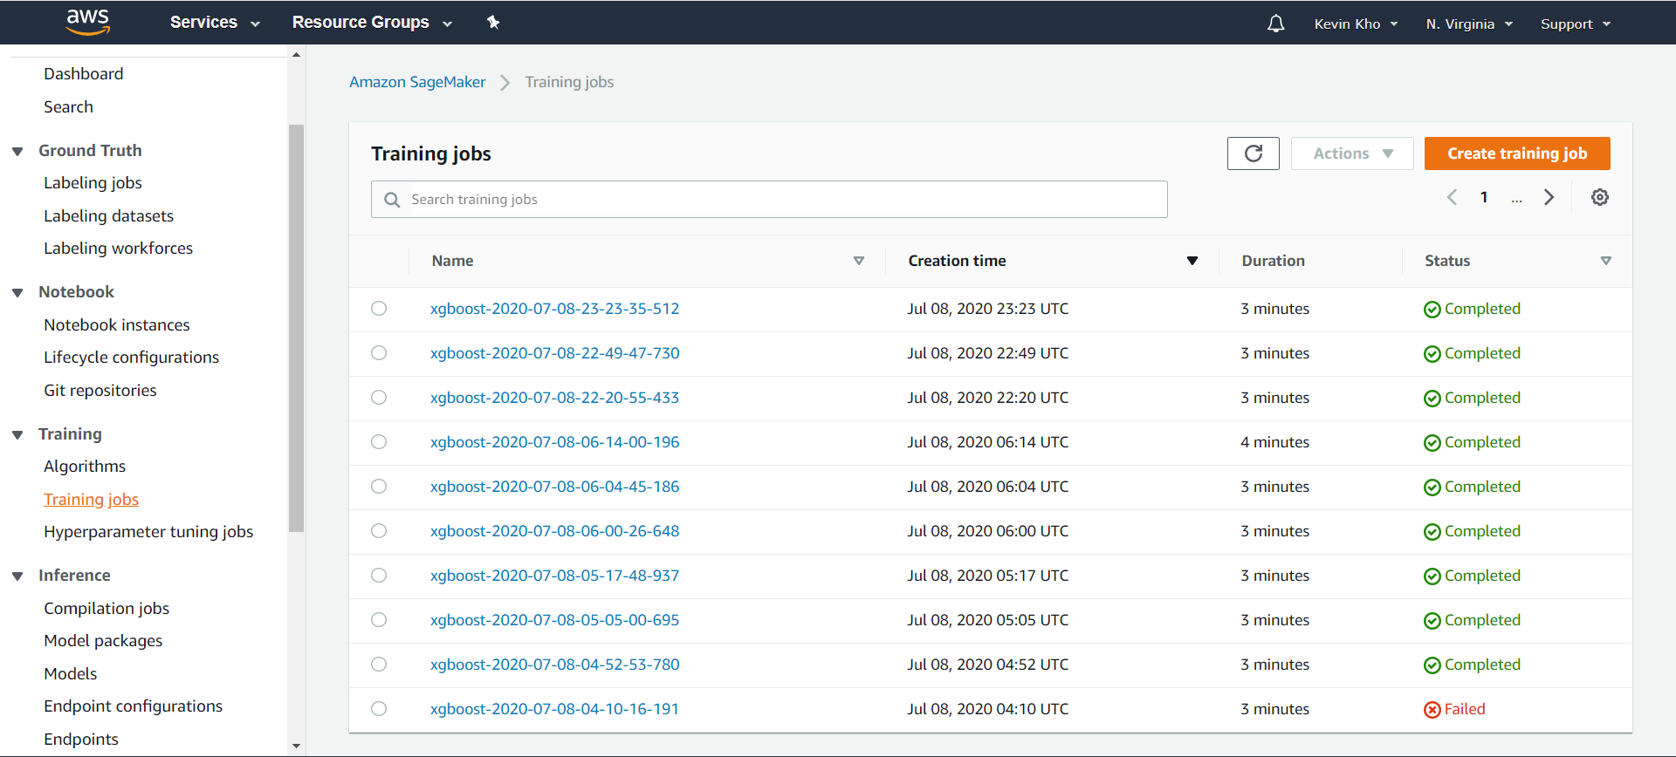
AWS SageMaker Training Jobs
Training

Slide 49
AWS SageMaker Training Jobs
Training
Create job (Lambda Integration)
Algorithm (in a container)
Resource Configuration (Spot Instances)
Data Paths (S3)

Slide 50
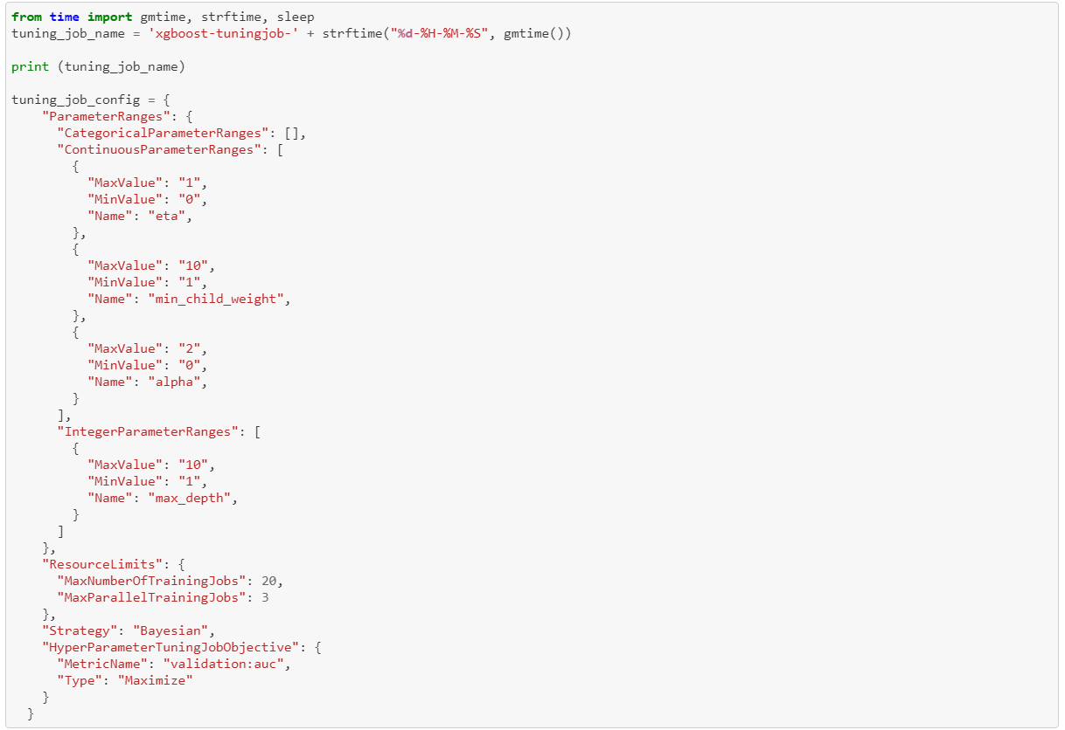
AWS SageMaker Hyperparameter Tuning
Training
Source: https://github.com/awslabs/amazon-sagemaker-examples/blob/master/hyperparameter_tuning/xgboost_direct_marketing/hpo_xgboost_direct_marketing_sagemaker_APIs.ipynb

Slide 51
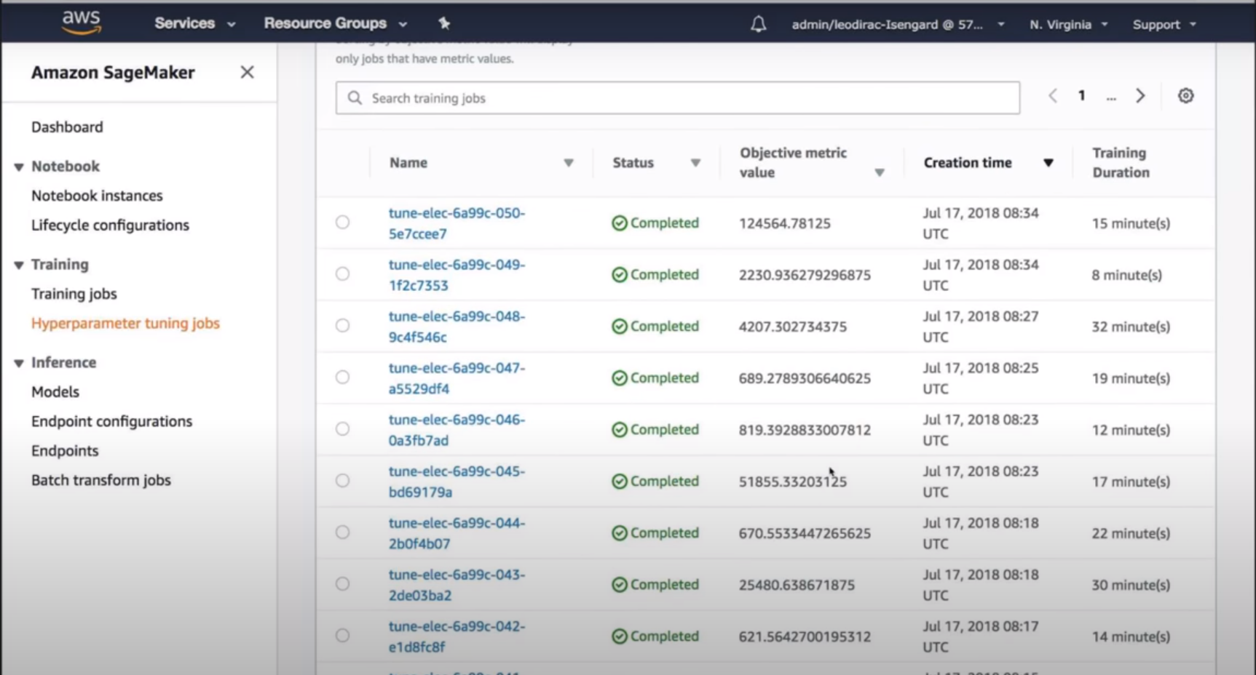
AWS SageMaker Hyperparameter Tuning
Training
Source: https://www.youtube.com/watch?v=ynYnZywayC4

Slide 52
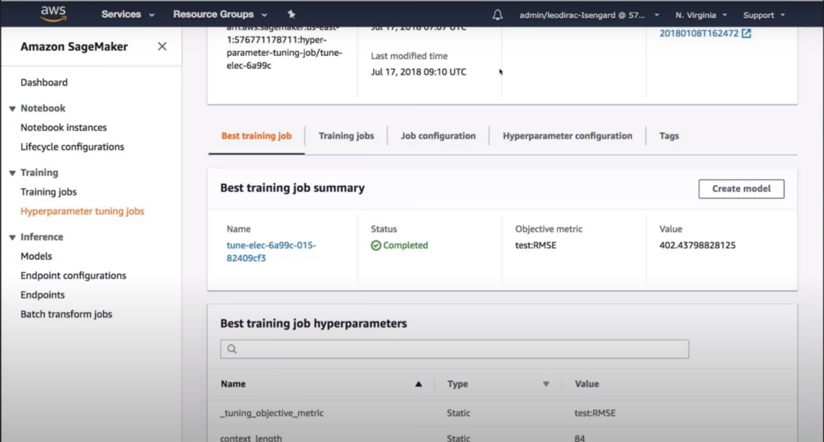
AWS SageMaker Hyperparameter Tuning
Training
Source: https://www.youtube.com/watch?v=ynYnZywayC4

Slide 53
AWS SageMaker Hyperparameter Tuning
API to Access Training Jobs
Get correlations versus hyperparameters
Warm Start
Parallelization

Slide 54
Pros
Training
Hyperparameter tuning is stronger than grid search
Works with any model (bring your own container)
Download and deploy elsewhere
Automatic model registry
Managed hardware

Slide 55
Cons
Training
Limited pre-built algorithms
Overhead of setting up container

Slide 56
Inference (Deploy)

Slide 57
SageMaker Interactions
Containers

Slide 58
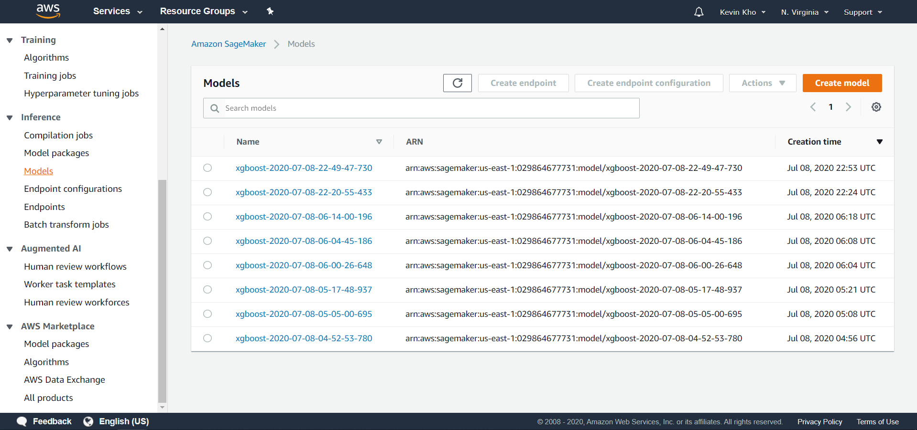
AWS SageMaker Model
Inference

Slide 59
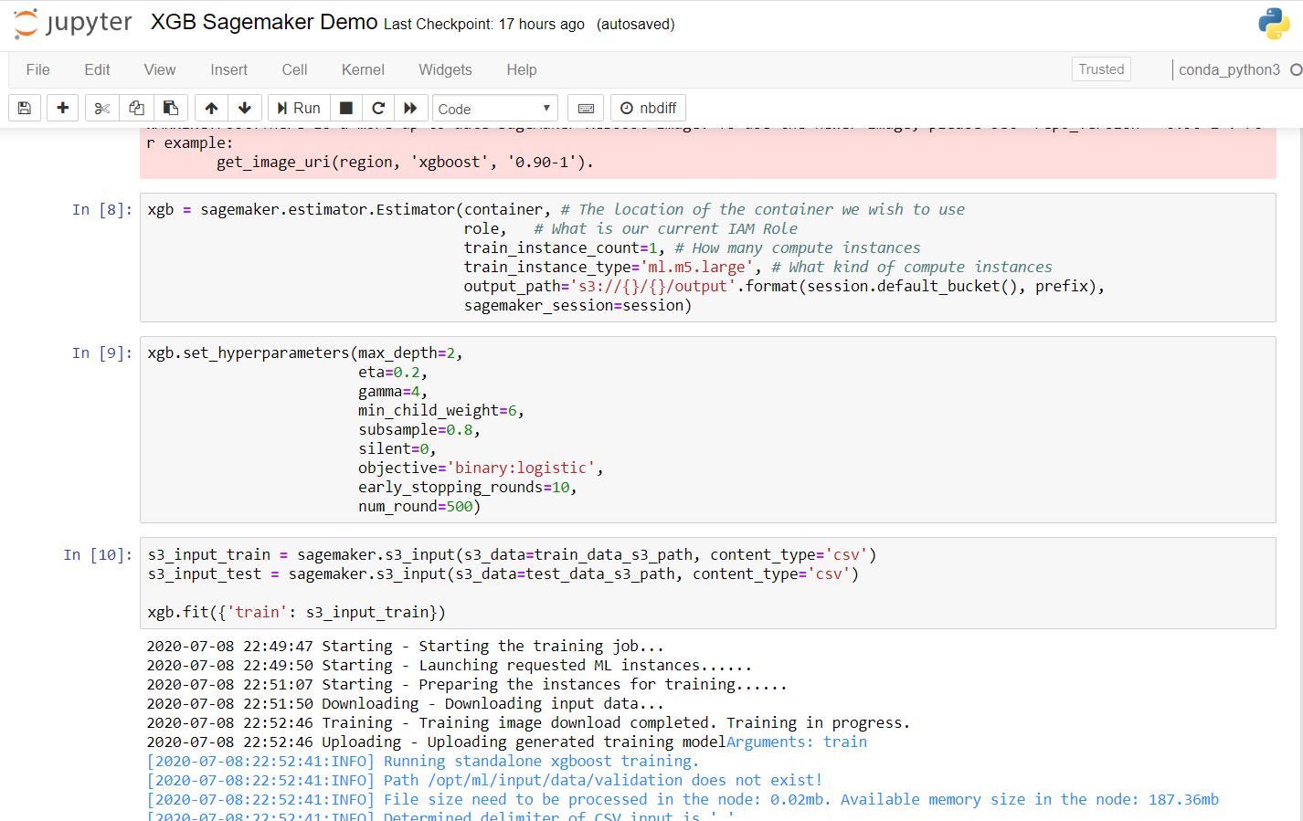
AWS SageMaker Model
Inference

Slide 60
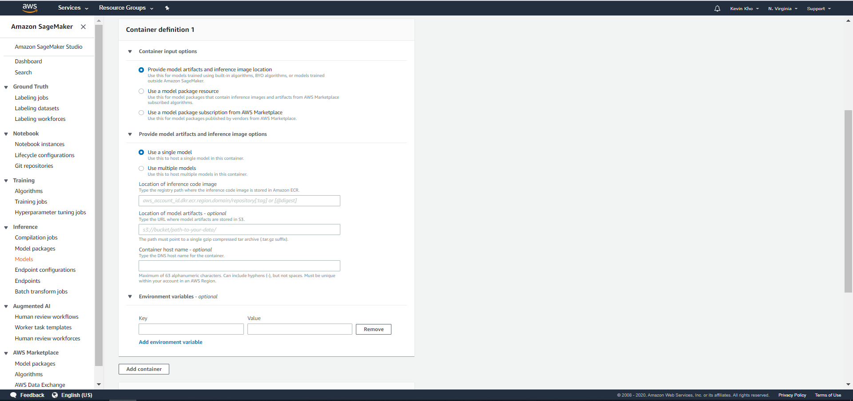
AWS SageMaker Inference Pipeline

Slide 61
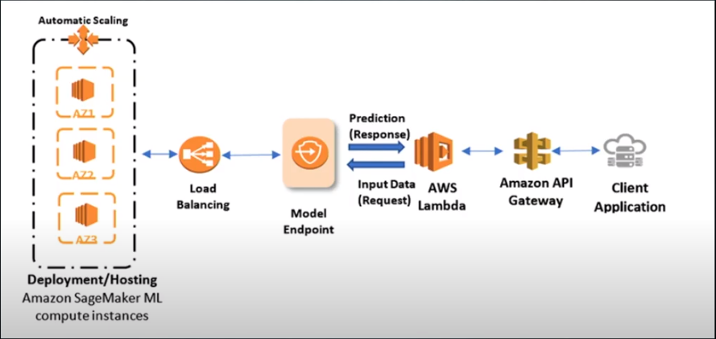
AWS SageMaker Endpoints
Inference
Source: https://www.youtube.com/watch?list=PLhr1KZpdzukcOr_6j_zmSrvYnLUtgqsZz&time_continue=21&v=KFuc2KWrTHs&feature=emb_logo

Slide 62
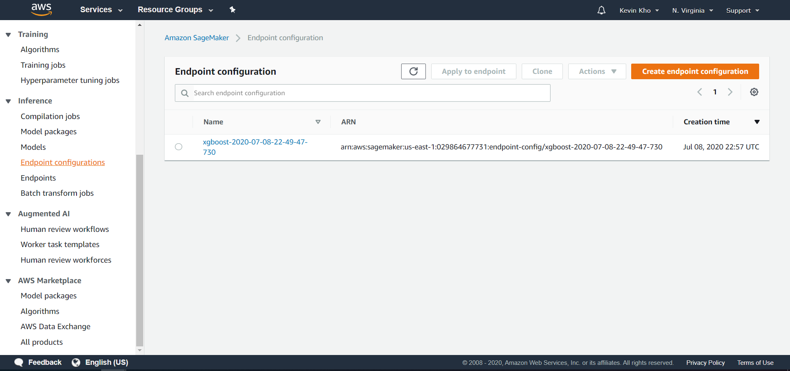
AWS SageMaker Endpoint Configuration
Inference

Slide 63
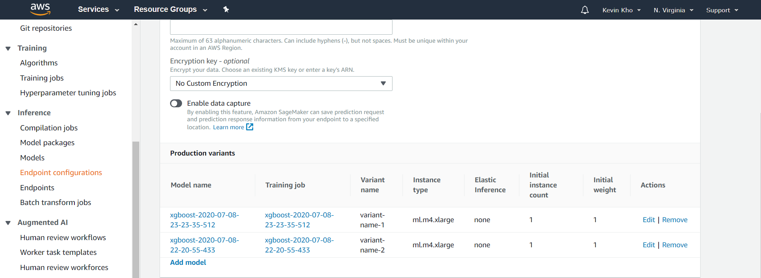
AWS SageMaker Endpoint Configuration
Inference

Slide 64
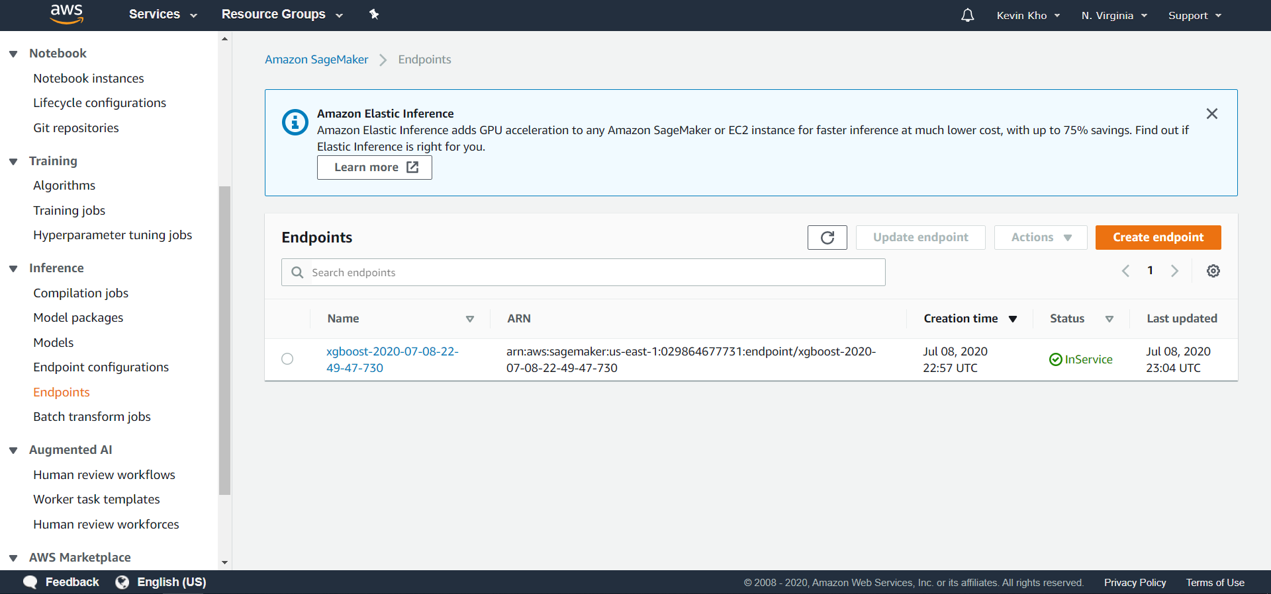
AWS SageMaker Endpoint
Inference

Slide 65
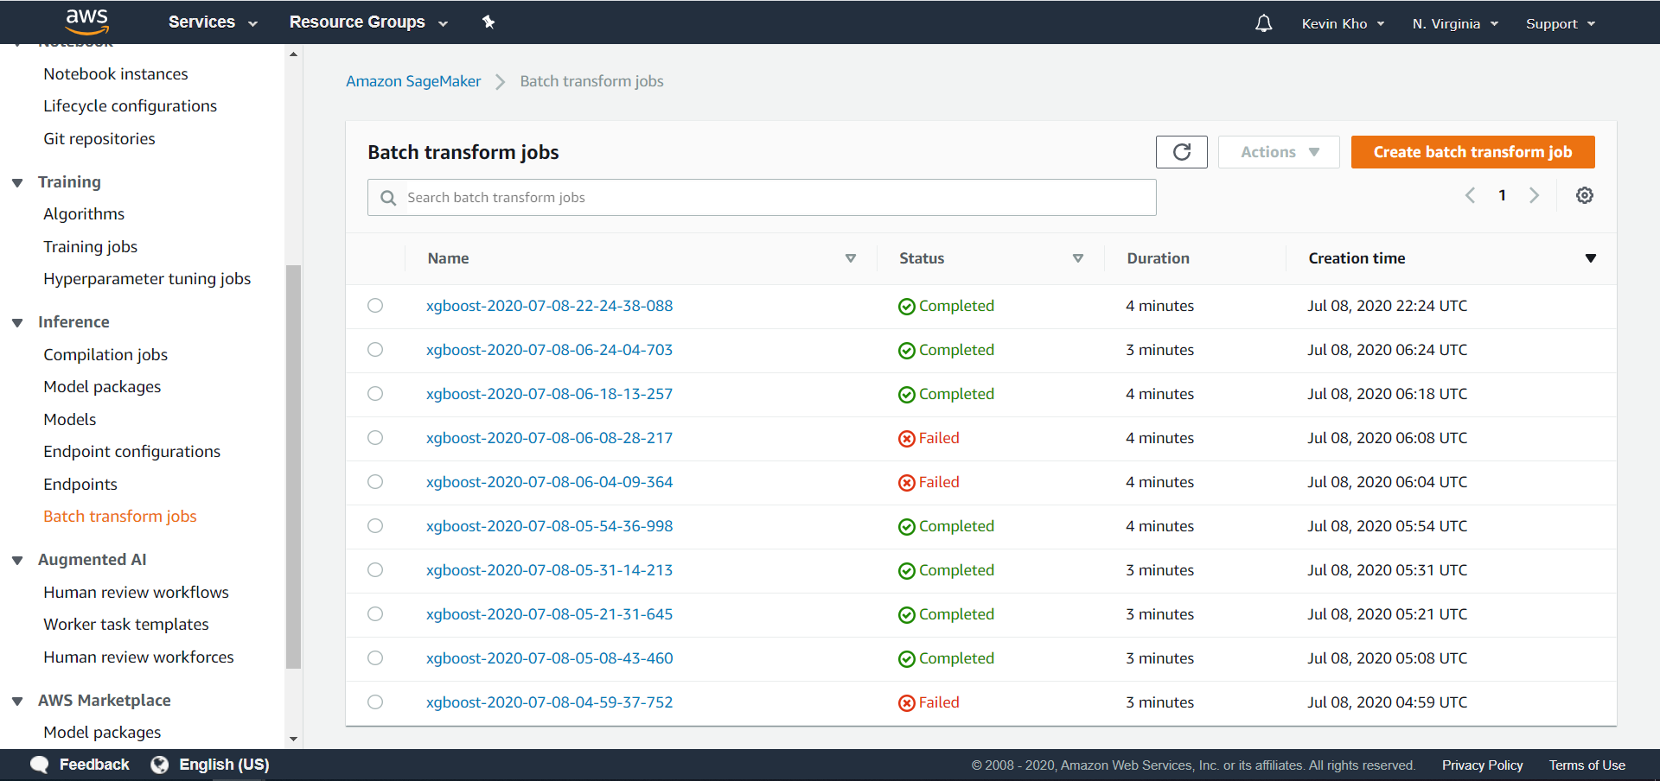
AWS SageMaker Batch Transform Jobs
Inference

Slide 66






AWS SageMaker Batch Transform Jobs
Inference
AWS Lambda
AWS Elastic Container Registry
AWS Step Functions
AWS SageMaker
Batch Jobs
AWS S3
AWS Lambda
Source: https://www.youtube.com/watch?v=Z9FtrRq0rc0
Source: https://stackoverflow.com/questions/55586412/how-to-schedule-task-in-aws-sagemaker-to-run-training-job

Slide 67
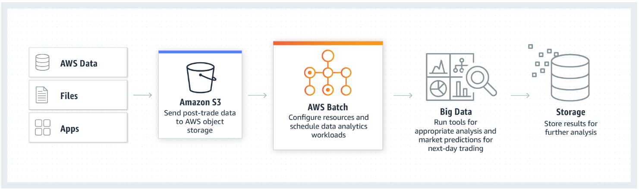
AWS Batch Alternative
Inference
Source: https://aws.amazon.com/batch/

Slide 68
AWS Batch Transform Max Batch Size
6 MB in MaxPayloadInMB
Transformers
Source: https://stackoverflow.com/questions/52649085/how-to-run-a-bigger-batch-with-aws-sagemaker-batch-transform

Slide 69
Pros
Inference
Quick deployment of endpoint
Auto-scaling
Container leads to versatility
A/B testing of models
Inference Pipelines

Slide 70
Cons
Inference
Scheduling batch jobs
S3 in – S3 out
Batch size. Transformations.
Resource Tracking (Notebooks can spin endpoints)
Feature Engineering might be better done elsewhere

Slide 71
Miscellaneous

Slide 72
Decoupled Infrastructure

Slide 73
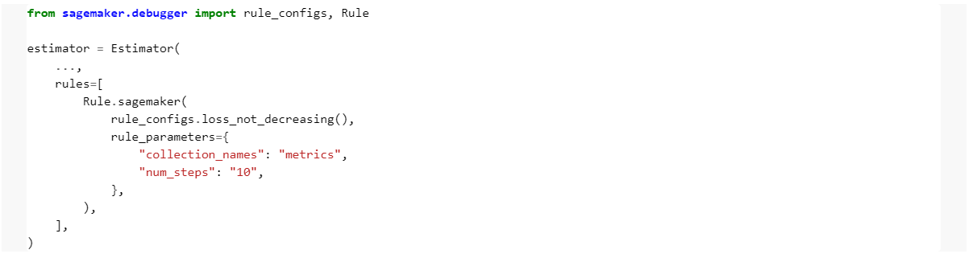
AWS SageMaker Debugger
Miscellaneous
Source: https://github.com/awslabs/amazon-sagemaker-examples/tree/master/sagemaker-debugger/xgboost_builtin_rules

Slide 74
AWS SageMaker Debugger
Miscellaneous
Built-in Rules
Vanishing gradient
Dead ReLu
All-zero
Overfit
Loss not decreasing
Tree depth
Source: https://docs.aws.amazon.com/sagemaker/latest/dg/debugger-built-in-rules.html

Slide 75
AWS SageMaker and Spark
Miscellaneous
Integration is mainly with AWS EMR
Feels awkward for training. Maybe more suitable for deployment.
PySpark implementation of SageMakerEstimator class
Source: https://docs.aws.amazon.com/sagemaker/latest/dg/apache-spark.html

Slide 76
AWS SageMaker and MLFlow
Miscellaneous
MLFlow has an API to deploy models to SageMaker
MLFlow can be used locally with an S3 backend
Source: https://cosminsanda.com/posts/experiment-tracking-with-mlflow-inside-amazon-sagemaker/
Source: https://www.mlflow.org/docs/latest/python_api/mlflow.sagemaker.html

Slide 77
Other Services
Miscellaneous
AWS Model Monitor
AWS Sagemaker NEO

Slide 78
Using SageMaker Locally
Miscellaneous

Slide 79
Questions
Miscellaneous
We probably didn’t reach here

